Slide 1


Stem Pairing
Week 6 Hua Jiang

Slide 2
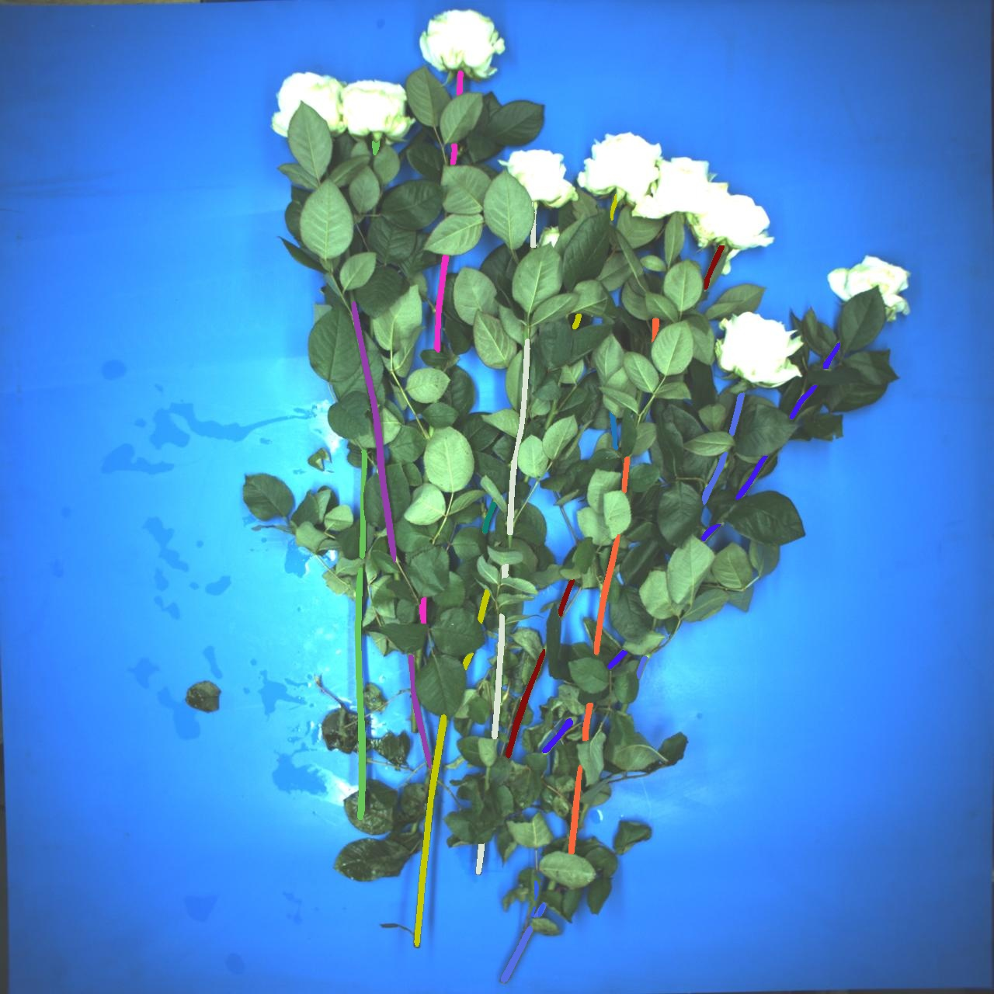
I design a handcrafted algorithm for stem pairing based on mask-rcnn output

Slide 3
1. Filtering: a section is computed to find potential stem pairs
20°
A maximum curvature of the bending stem

Slide 4
upper
1.1. Further restrict: orientation and position
20°
left
right
12.5°
10°
lower

Slide 5
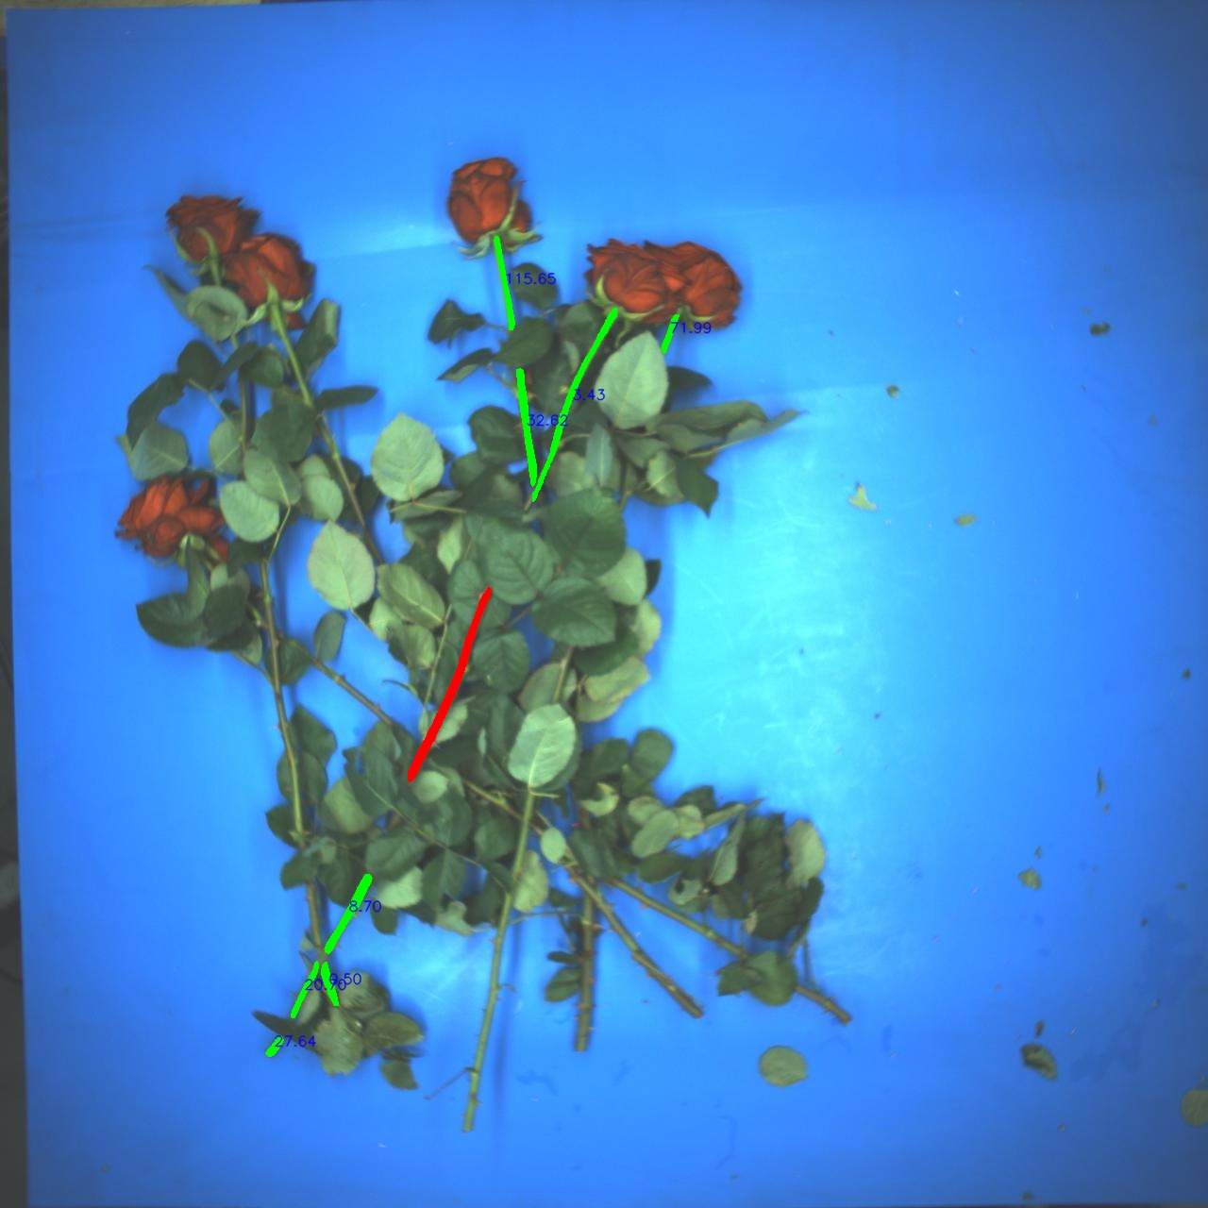

1.1. Further restrict: orientation and position

Slide 6
ang
r
2. Score Computing:
Score = r*ang
The lower the better – priority belongs to the one closer and with smaller orientation difference
20°

Slide 7
3. Iteration and Pairing
In one iteration, if stem i and j are each other’s lowest score, they are paired

Slide 8
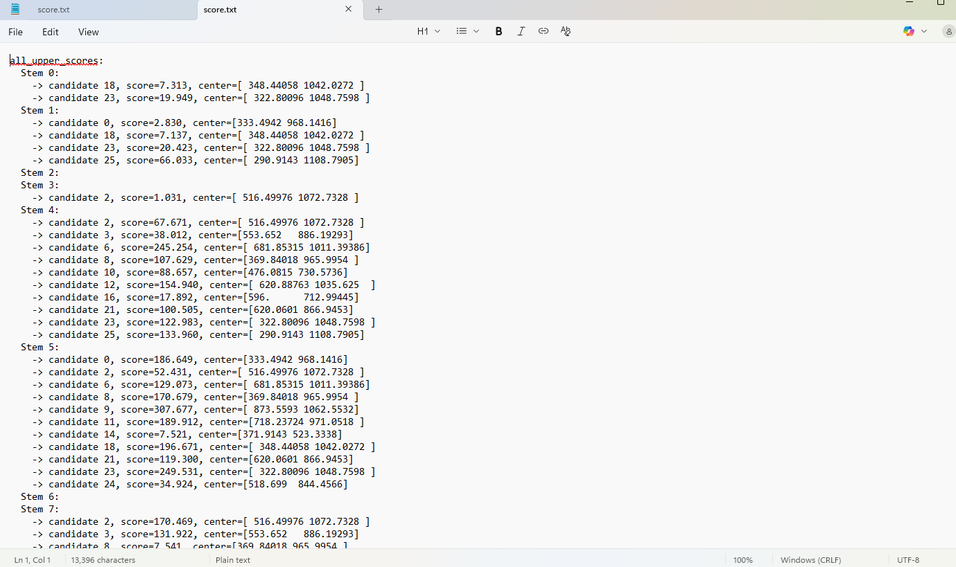
3. Iteration and Pairing
Trick: If there are multiple candiates with score less than 10, the closest one will be picked

Slide 9

3. Iteration and Pairing
Trick: If there are multiple candiates with score less than 5, the closest one will be picked
Even with the lowest score, the further, more irrelavent.

Slide 10
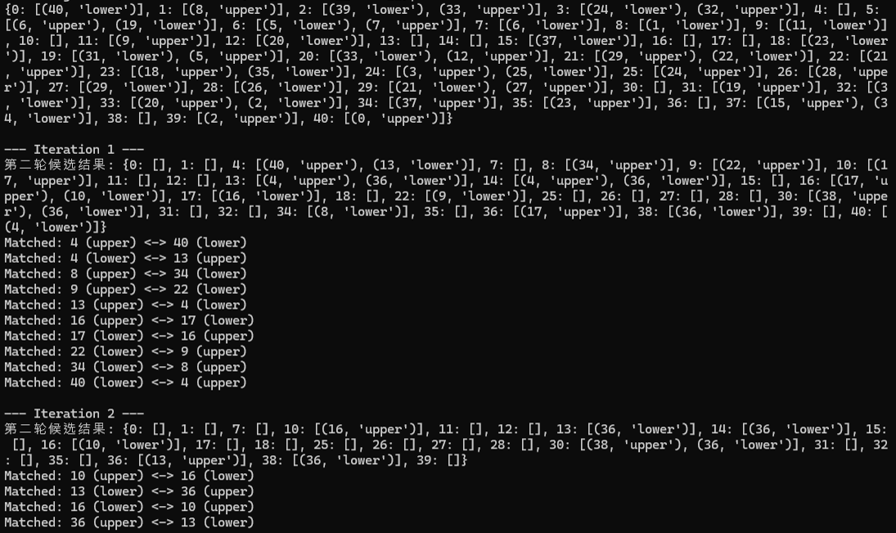
3. Iteration and Pairing
Once two stems are paired, they will be removed from the set
Iteration till there is no more pairing

Slide 11
3. Iteration and Pairing
Once two stems are paired, they will be removed from the set
Iteration till there is no more pairing
A little mistake

Slide 12


Outside the section

Slide 13

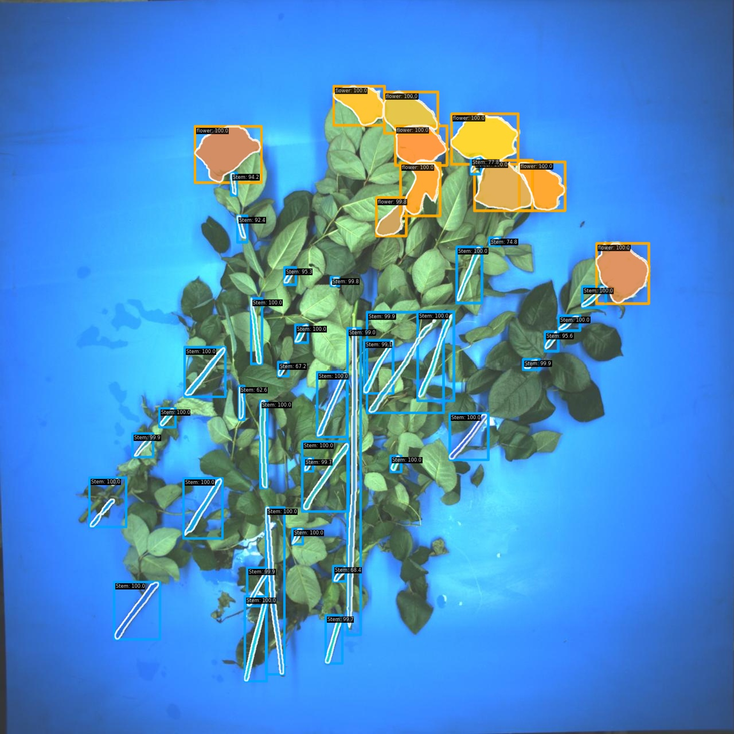

Slide 14
Future Work:
Improve the mask-rcnn model
Top Stem selection algorithm

